Slide 1

Dr-Muhammad Awak
NATIONAL GUIDELINES IN RADIOTHERAPY

Slide 2

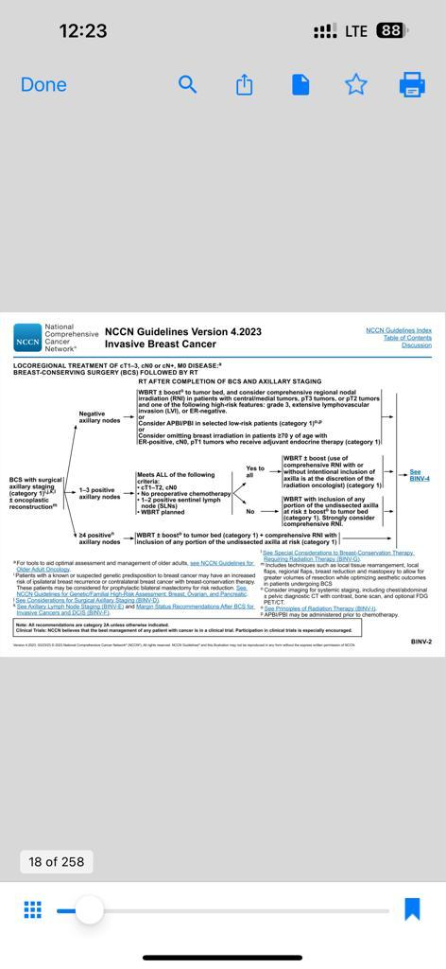
Breast Cancer
INDICATIONS- BCS

Slide 3
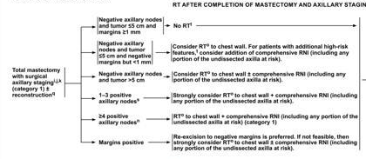
Breast Cancer
INDICATIONS- Mastectomy

Slide 4
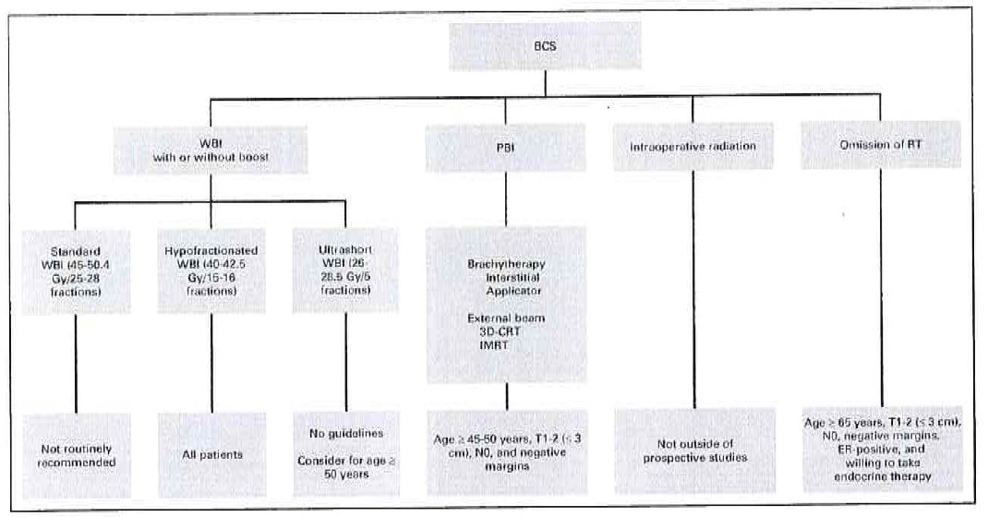
Breast Cancer
Irradiation & systemic therapy

Slide 5
Breast Cancer immobilization
The patient positioned supine on the Chest Bord
Wedge under knee
The arm on the affected side should be raised on the arm support ( angle >90)
The Opposite arm rest at the patient’s body

Slide 6
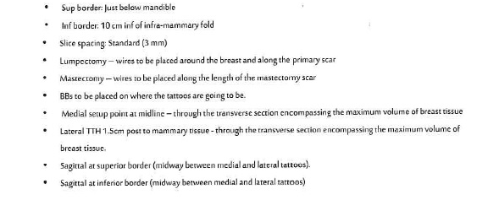
Breast Cancer
Pre- scanning

Slide 7
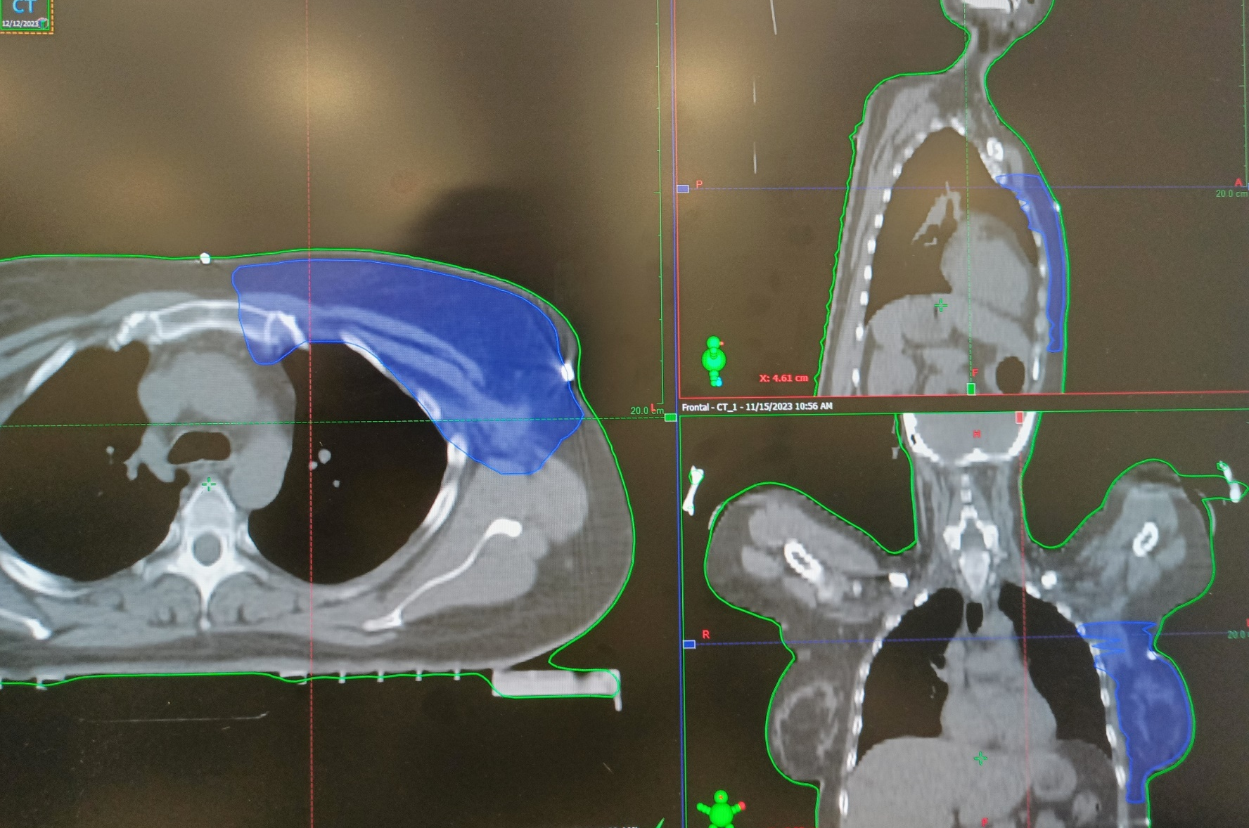
Breast Cancer
Target volumes- post lumpectomy
No GTV
The whole breast is the CTV 5mm below the skin
The aim is t treat all the glandular breast tissue down to deep fascia, but not the under lying muscle, rib cage, overlying skin or excision scar
Boost Tumor bed
The tumor bed can be visualized using clips placed at surgery around the wall of surgical cavity
The Boost CTV includes: Tumor bed + any seroma
The case of absence of surgical clips, seroma, post operative fibrosis and scaring , pre surgical images should be used as guidance to localized tumor bed

Slide 8
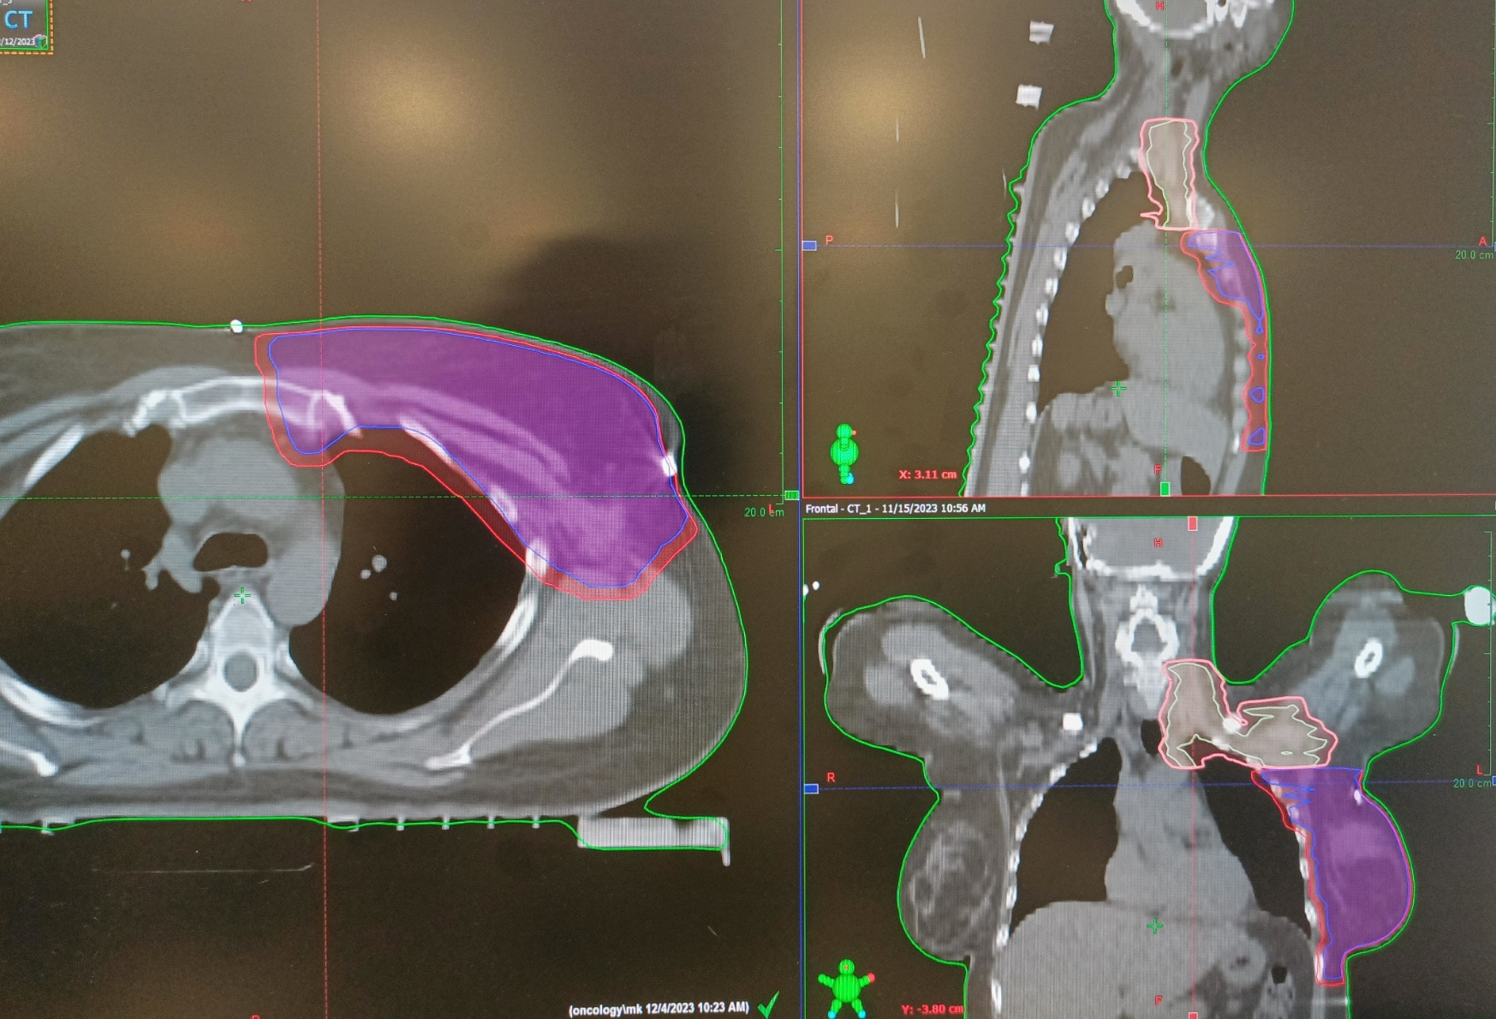
Breast Cancer
Target volumes- post lumpectomy
Lumpectomy CTV: Lumpectomy cavity with a 1- 1.5 cm expansion, this volume should not extend into the pectoralis muscle and/ or muscles of chest wall
Lumpectomy PTV: Lumpectomy CTV with margin based on setup uncertainly and predicted patient motion
Adjustments to this volume may be necessary for dose reporting purposes

Slide 9
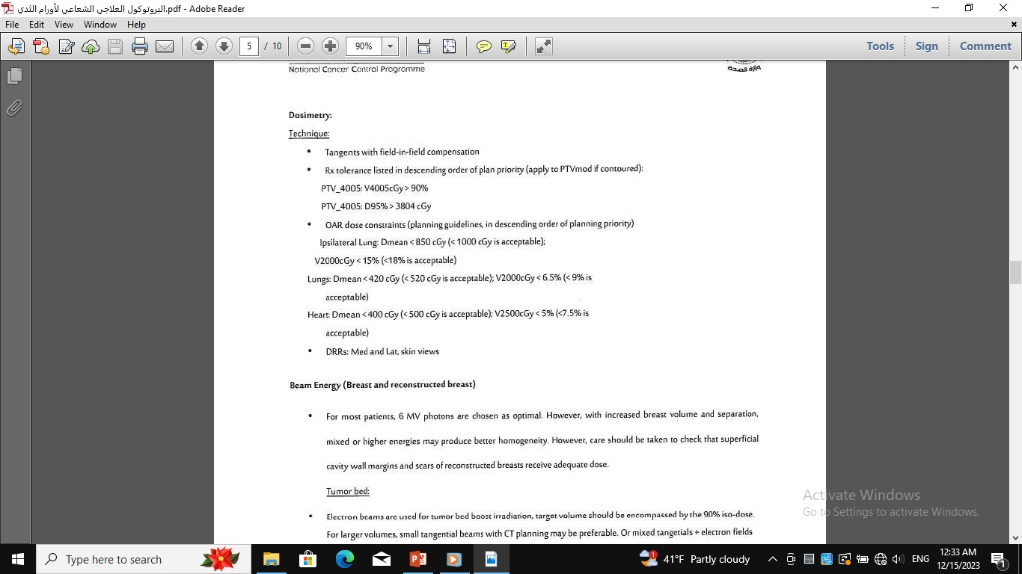
Breast Cancer- post lumpectomy- Dosimetry

Slide 10
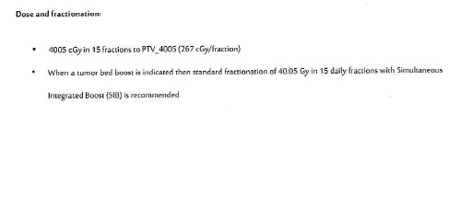
Breast Cancer- post lumpectomy
Dose and fractionation:

Slide 11
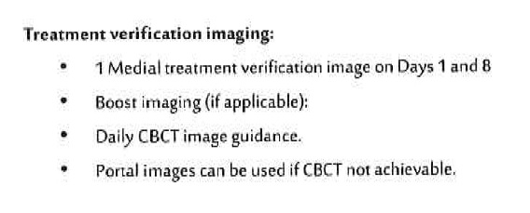
Breast Cancer- post lumpectomy
Treatment verification imaging:

Slide 12
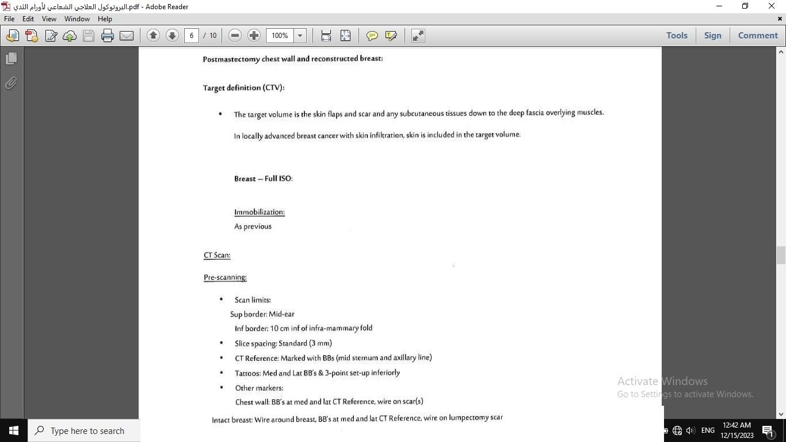
Breast Cancer- Post mastectomy chest wall & reconstructed breast
Full ISO
Partial breast irradiation

Slide 13
Breast Cancer- Full ISO- pre scanning

Slide 14
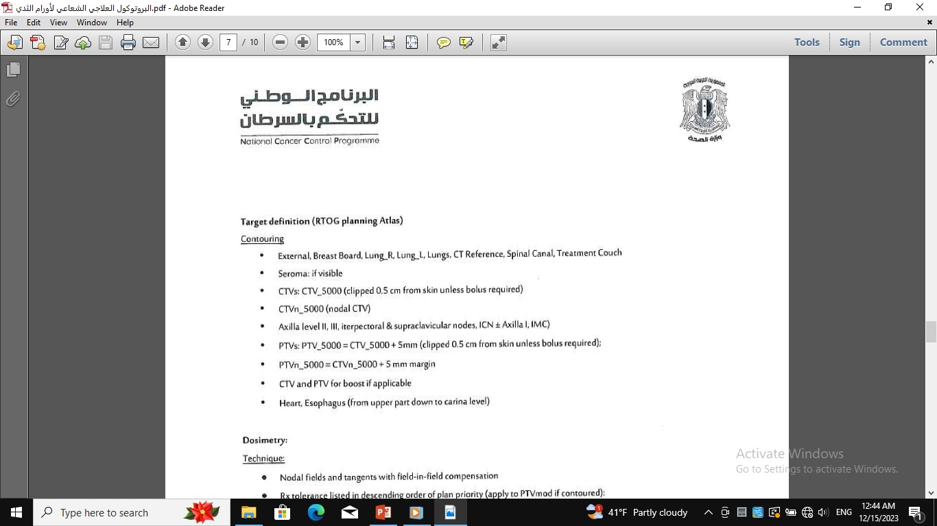
Breast Cancer- Full ISO- Target definition

Slide 15
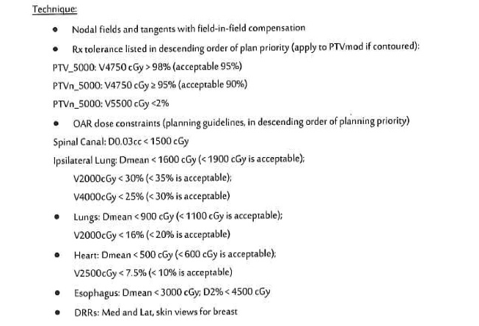
Breast Cancer- Full ISO- Dosimetry

Slide 16
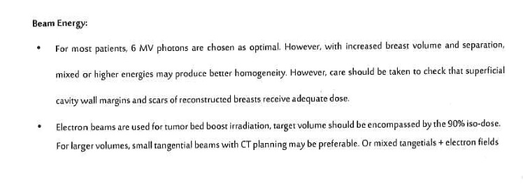
Breast Cancer- Full ISO- Dosimetry

Slide 17
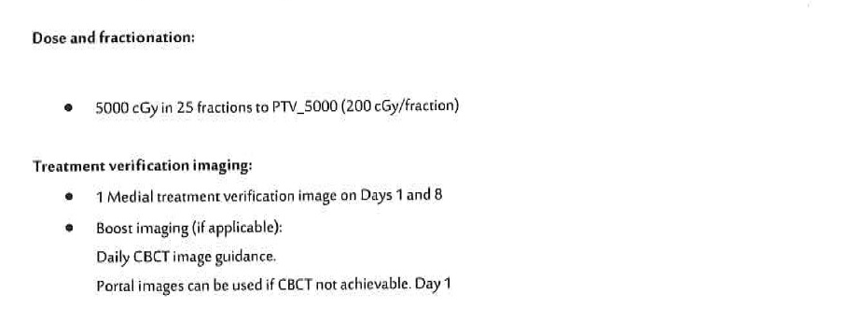
Breast Cancer- Full ISO
Dose and fractionation:

Slide 18
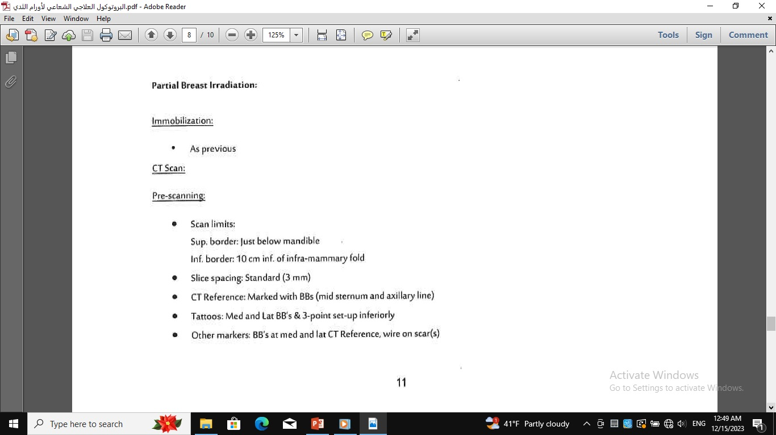
Breast Cancer- Partial breast irradiation pre scanning

Slide 19
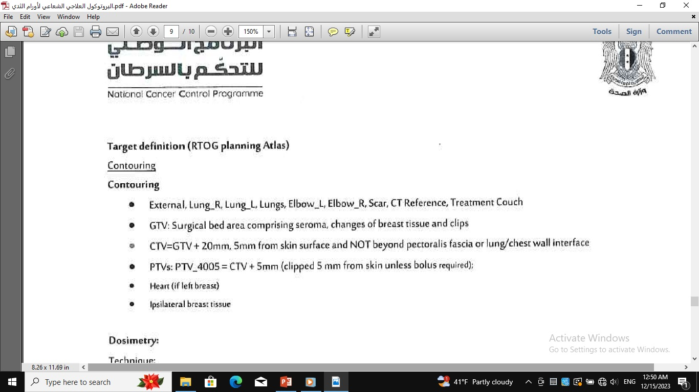
Breast Cancer- Partial breast irradiation
Target definition

Slide 20
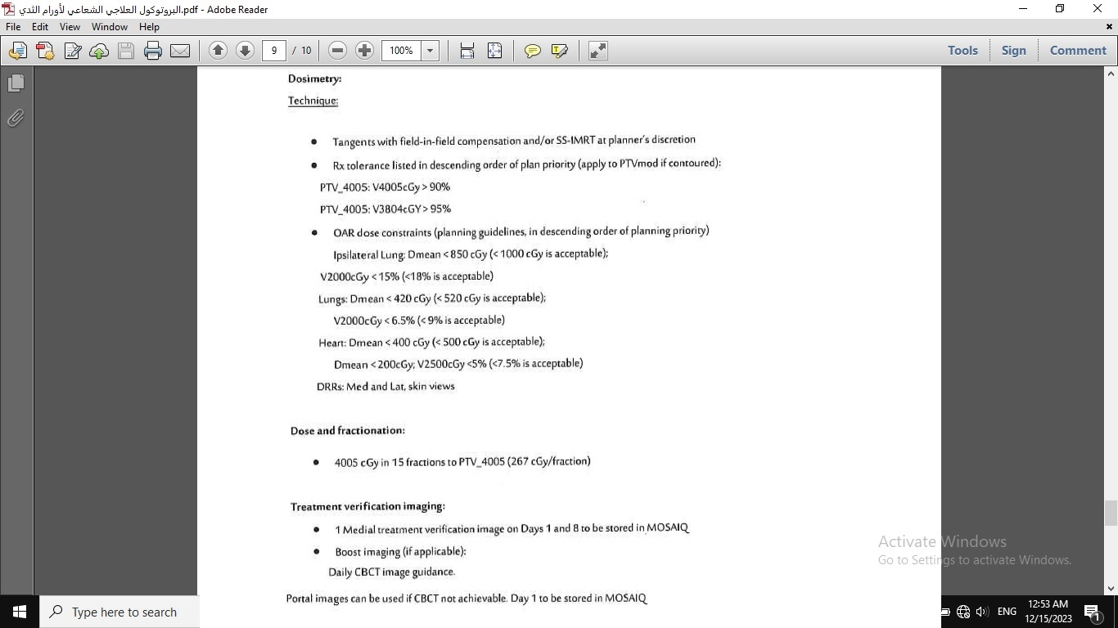
Breast Cancer- Partial breast irradiation
Dosimetry

Slide 21

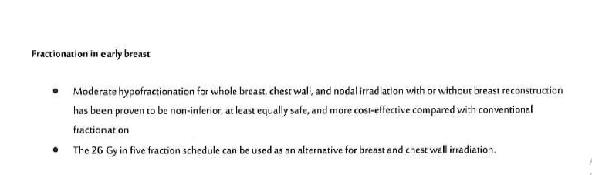
Breast Cancer- Partial breast irradiation-Dosimetry

Slide 22
Thanks for listening

Slide 23

Dr- Zyad Marawi
NATIONAL GUIDELINES IN RADIOTHERAPY

Slide 24
Prostate Cancer indications of RT in Prostate cancer:
Post surgical IMRT
Intermediate/ high risk, no node, IMRT
High risk with nodes IMRT Single Phase
Post surgical with nodes IMRT
Prostate & pelvic nodes IMRT- After HDR Prostate
Prostate Nodal and Non-Spinal Bone Oligometastasis

Slide 25
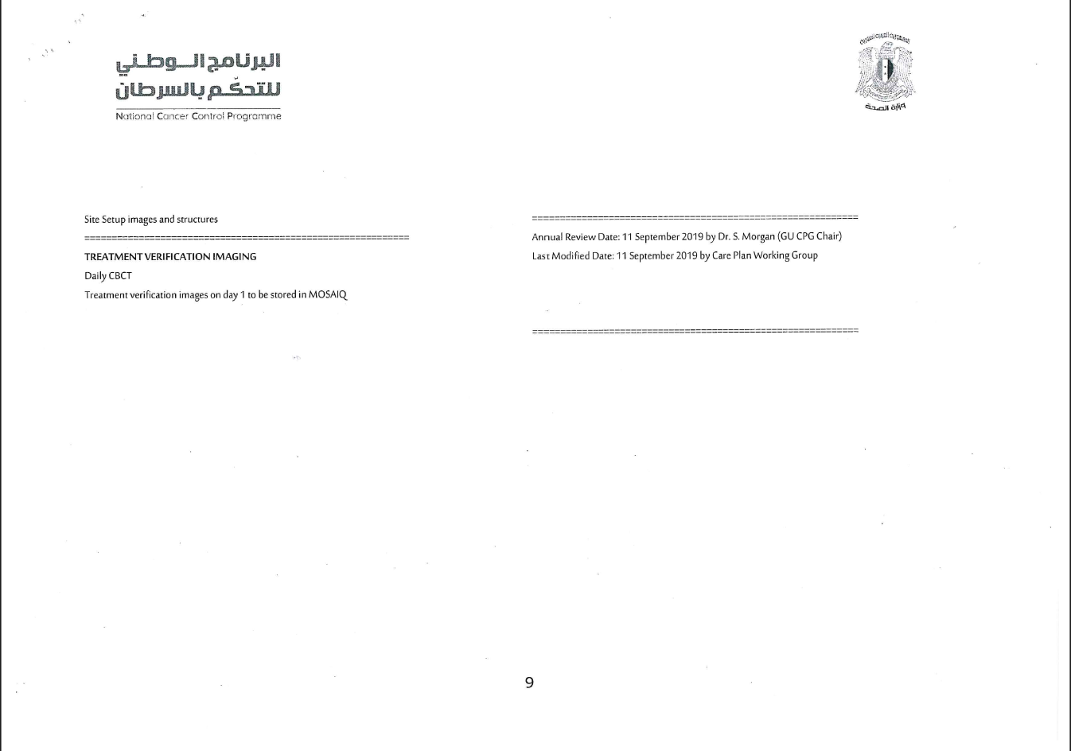

Slide 26
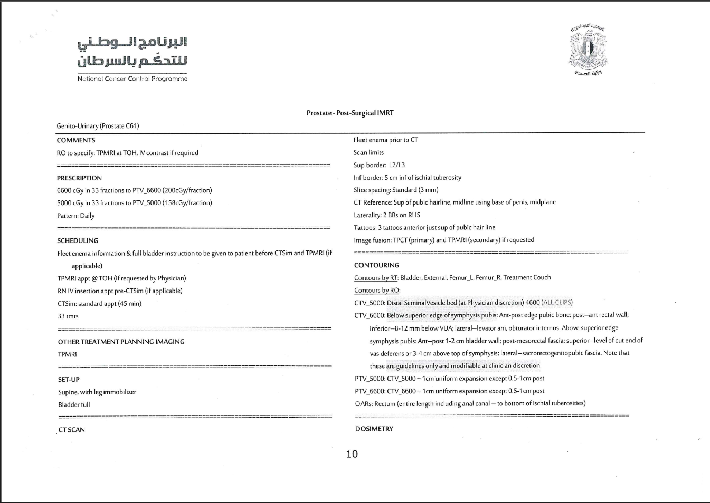

Slide 27
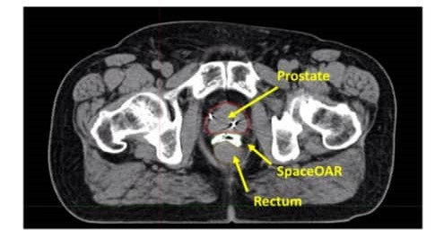

Slide 28
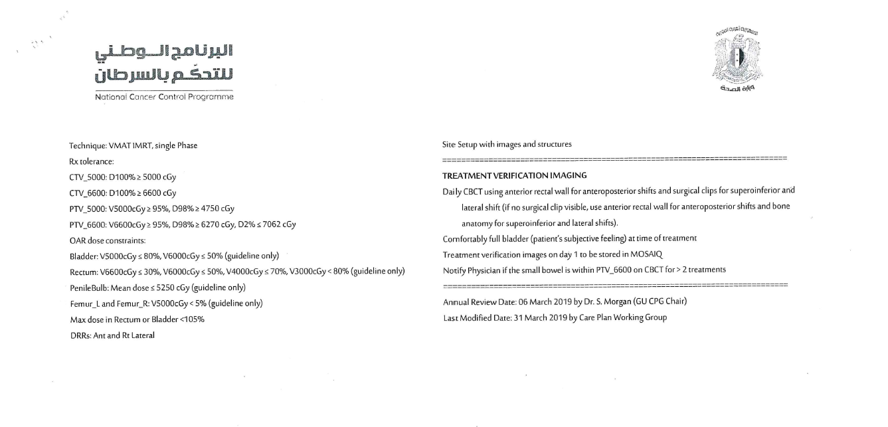

Slide 29
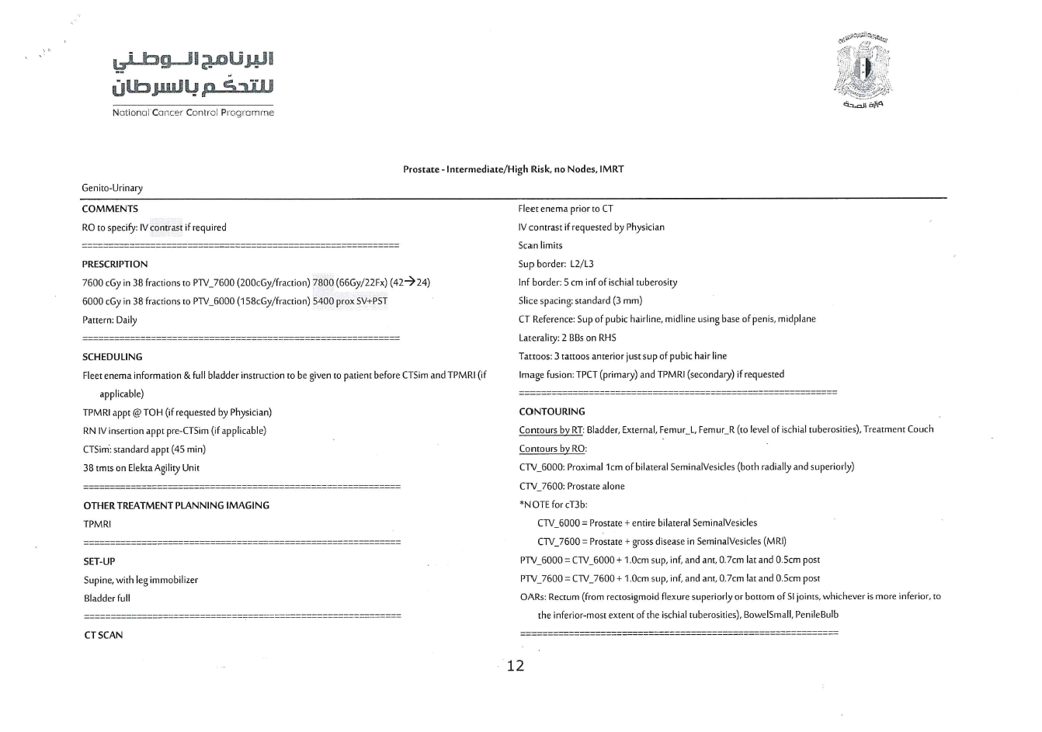

Slide 30
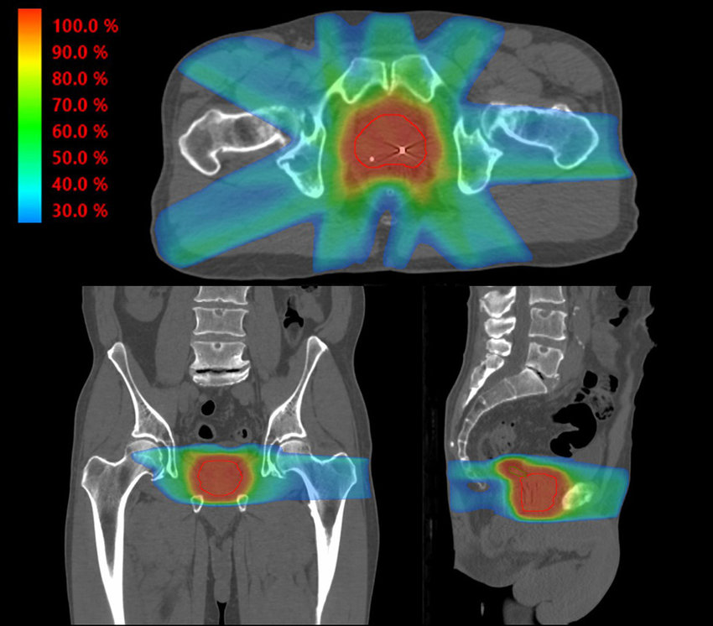

Slide 31
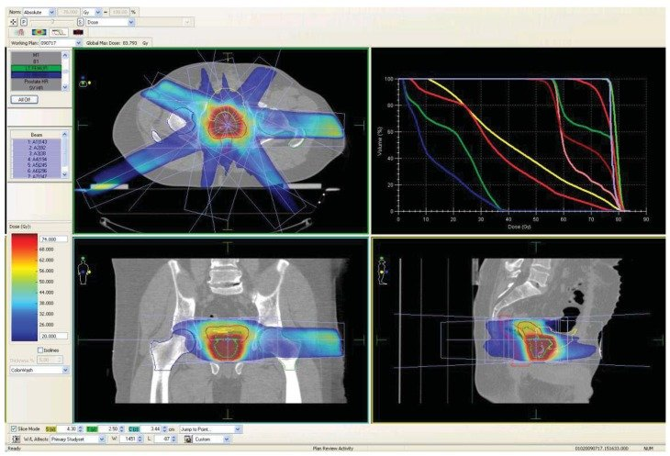

Slide 32
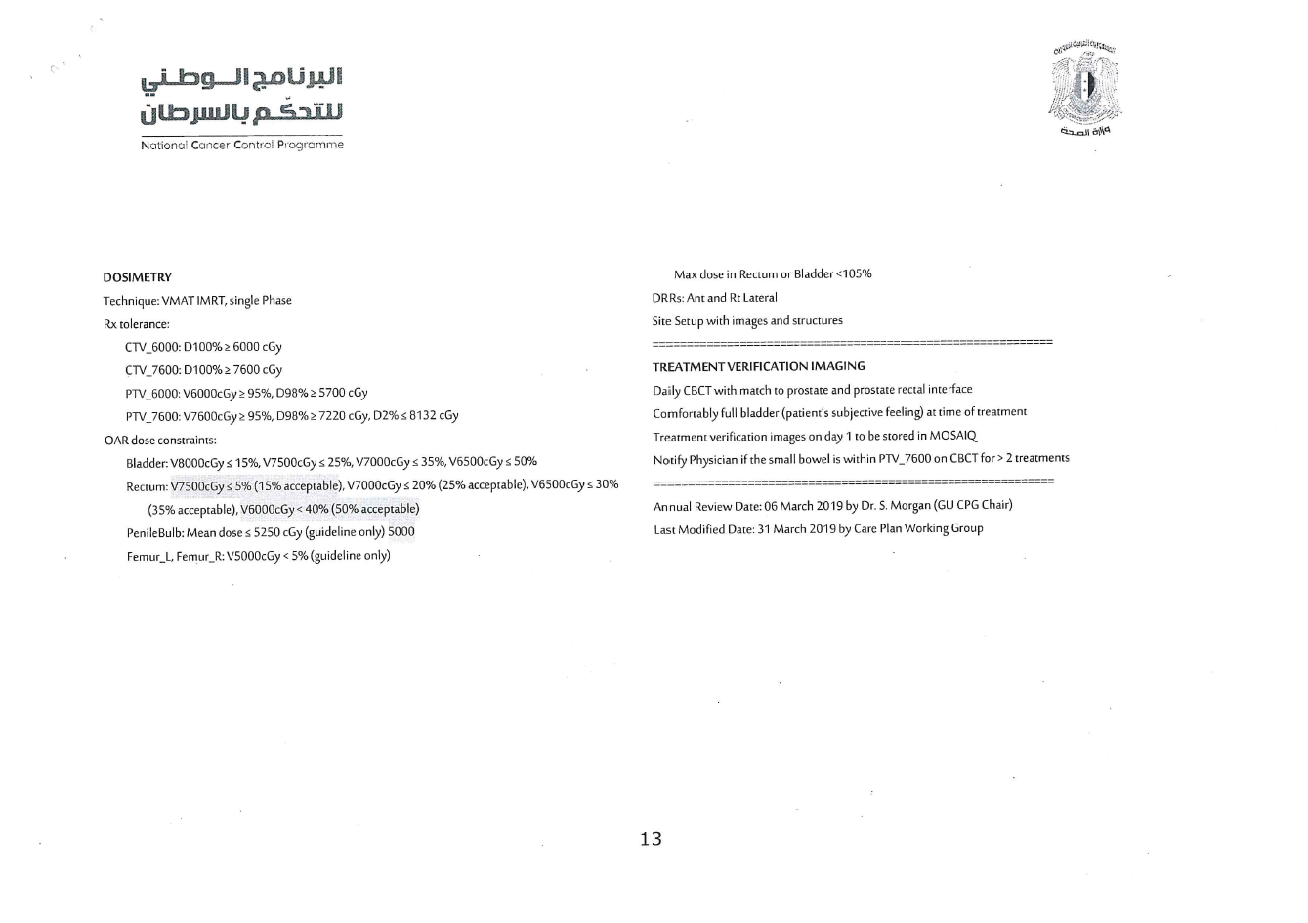

Slide 33
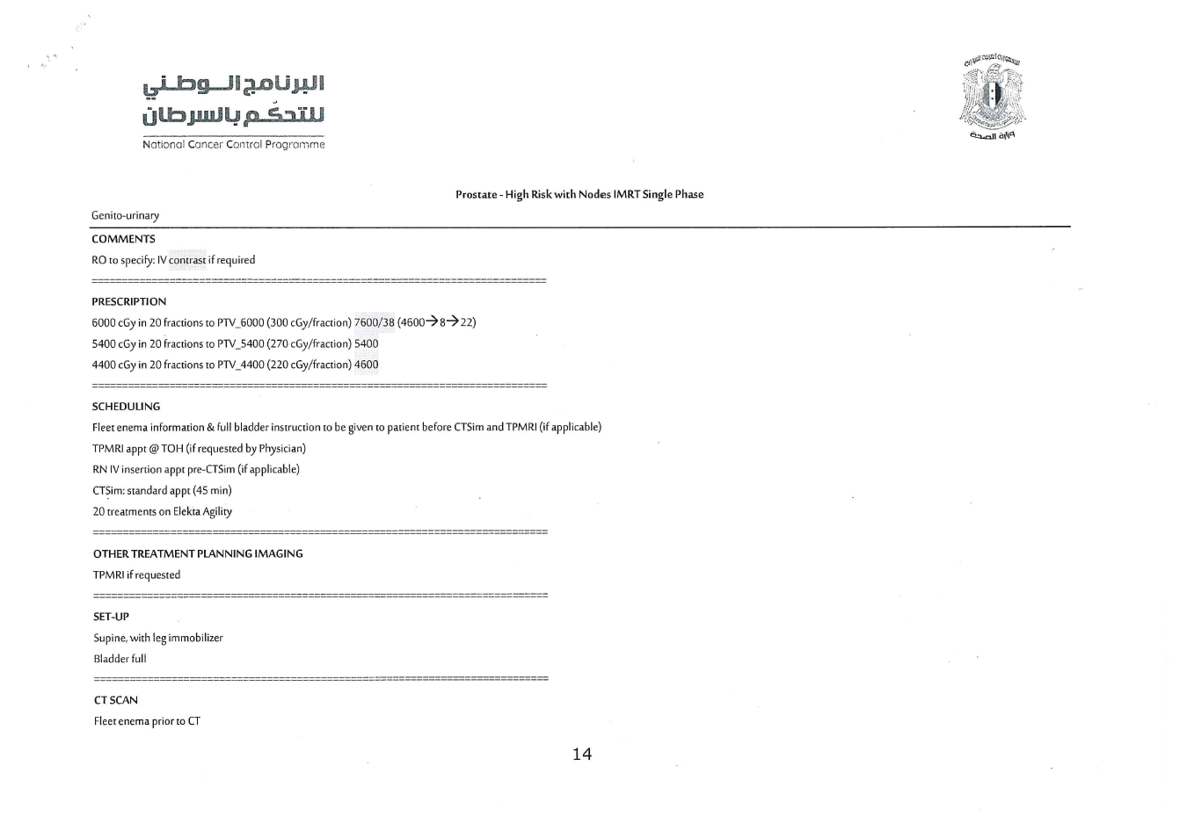

Slide 34
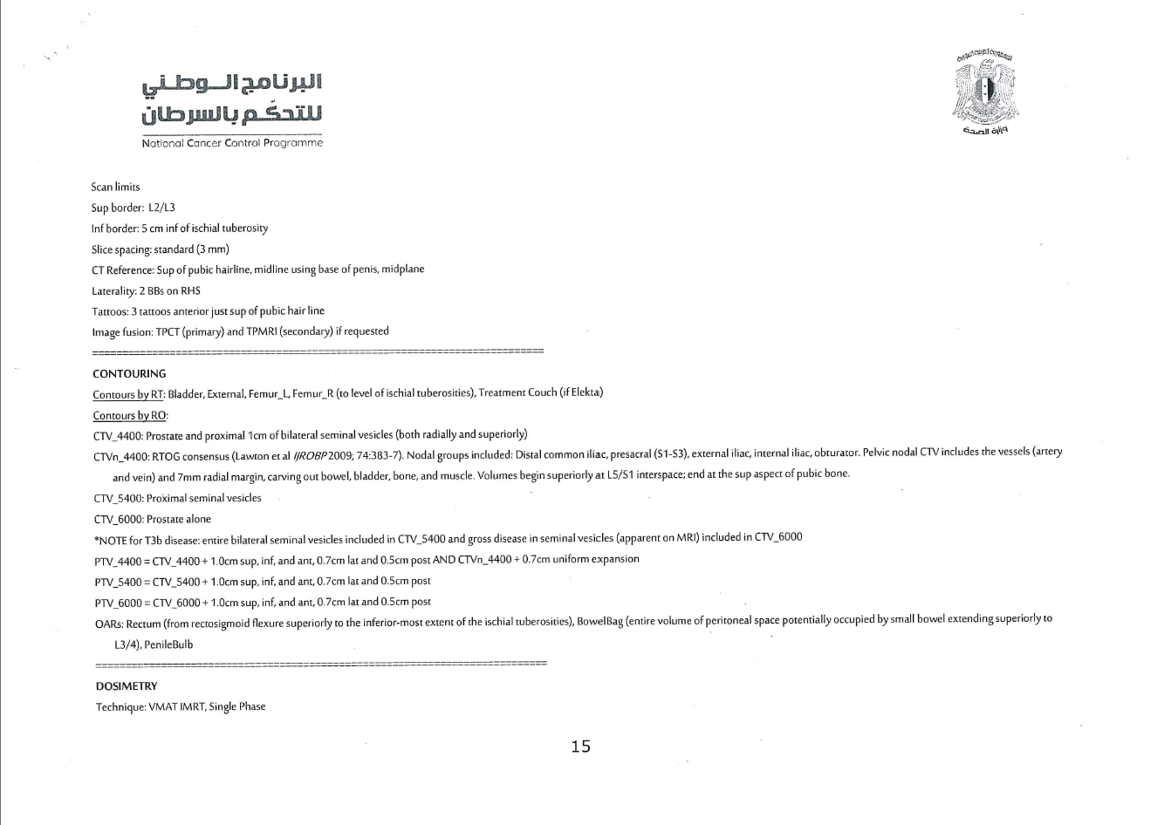

Slide 35
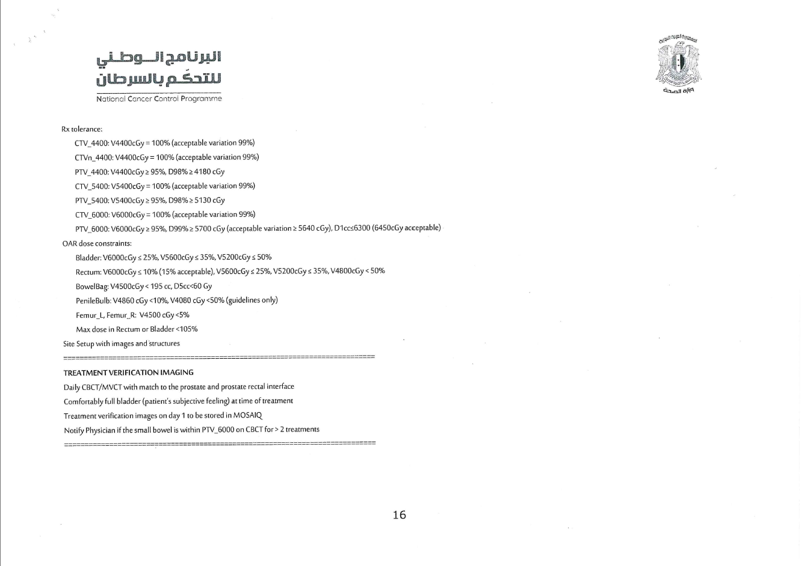

Slide 36
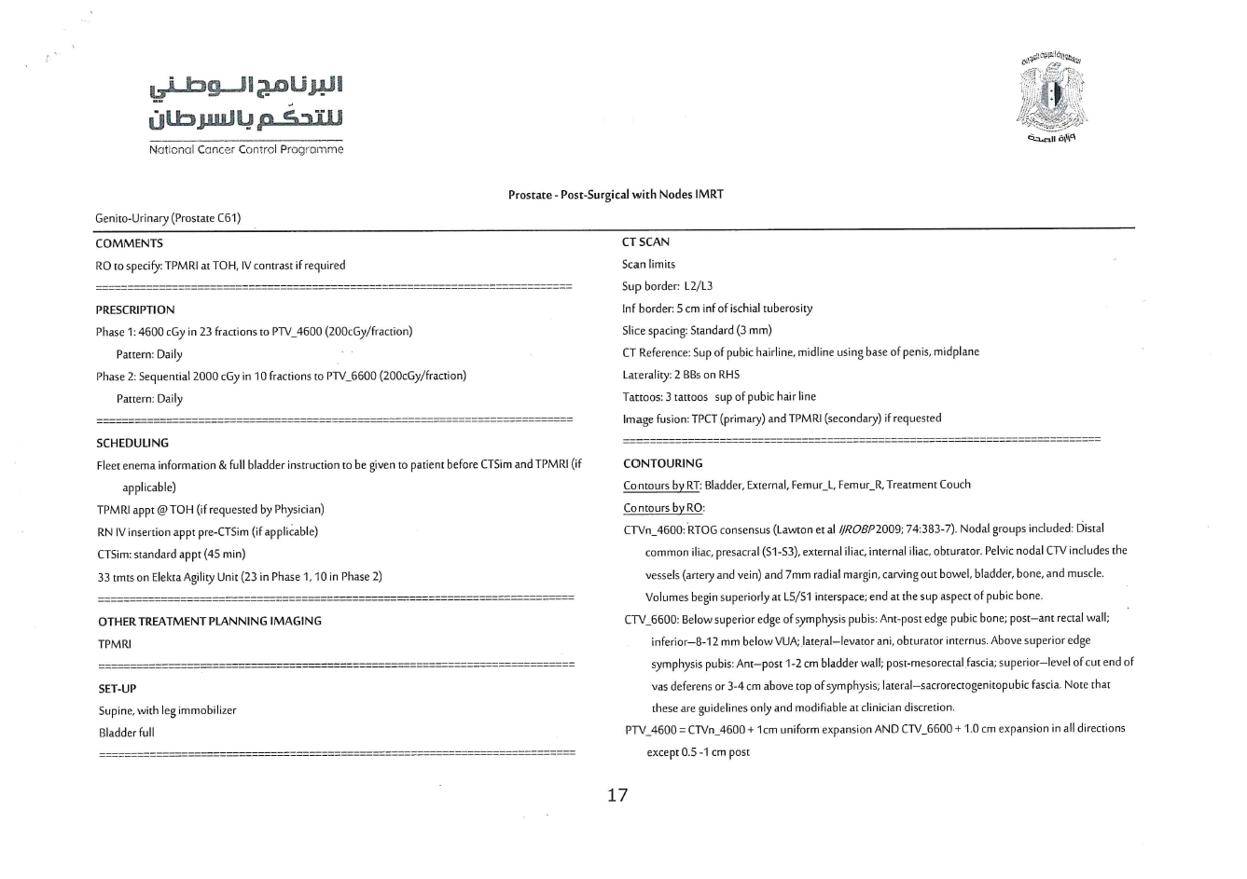

Slide 37
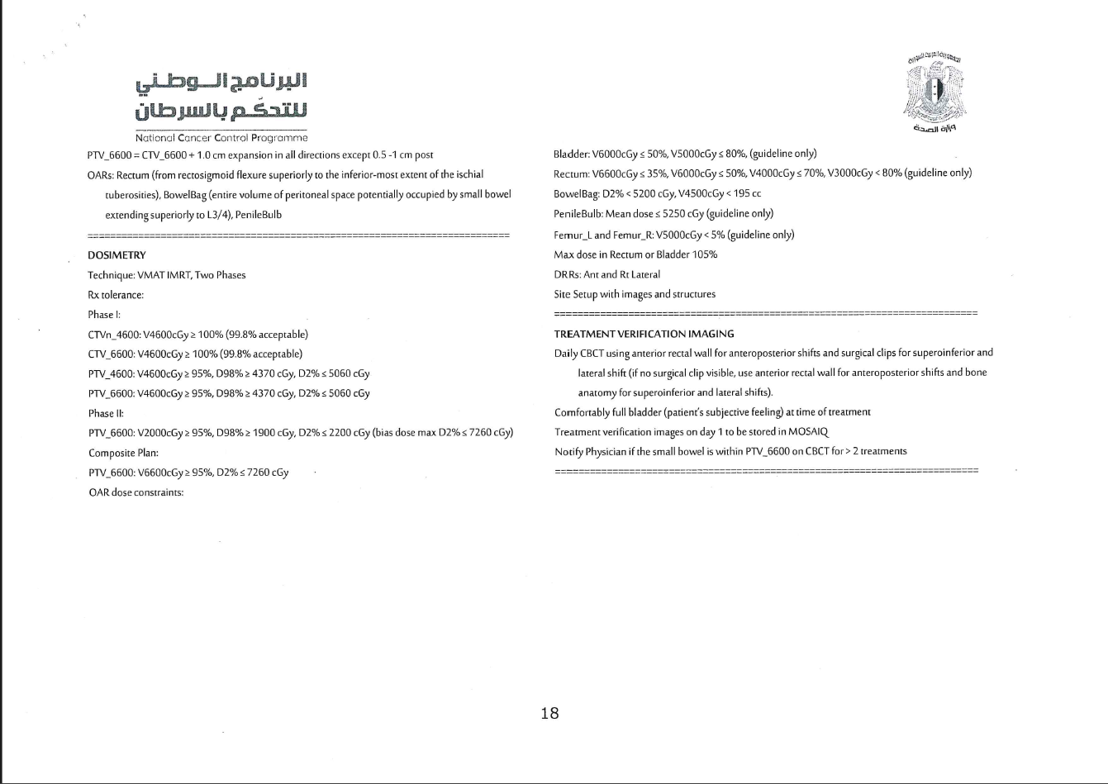

Slide 38
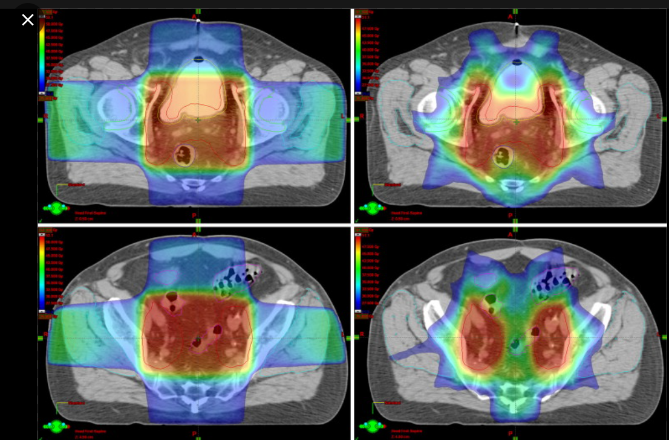

Slide 39
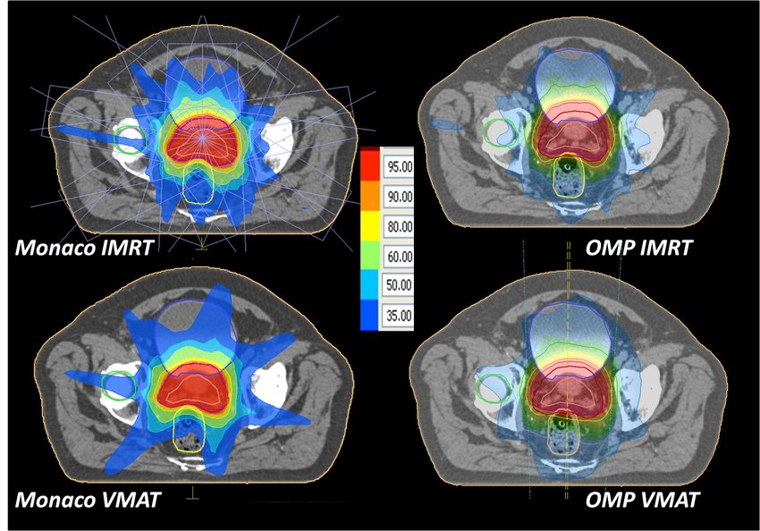

Slide 40
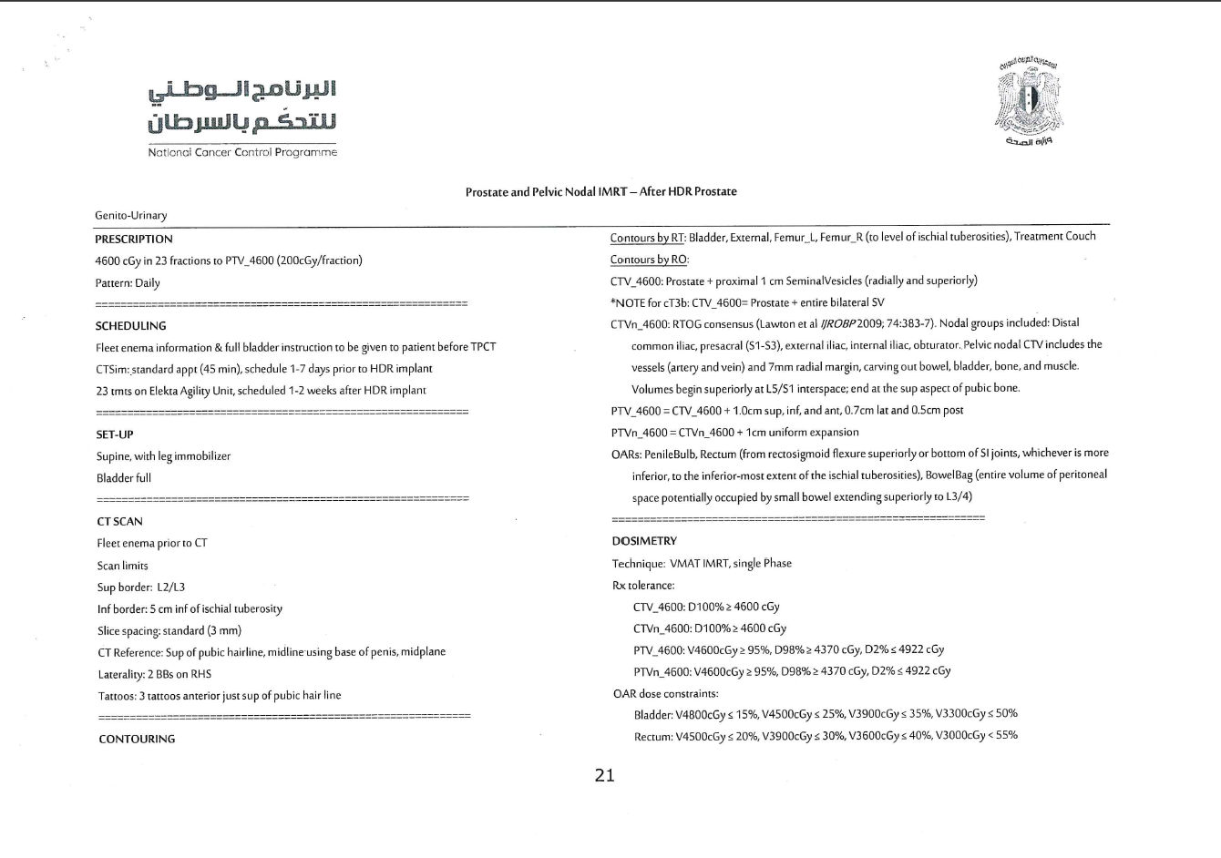

Slide 41
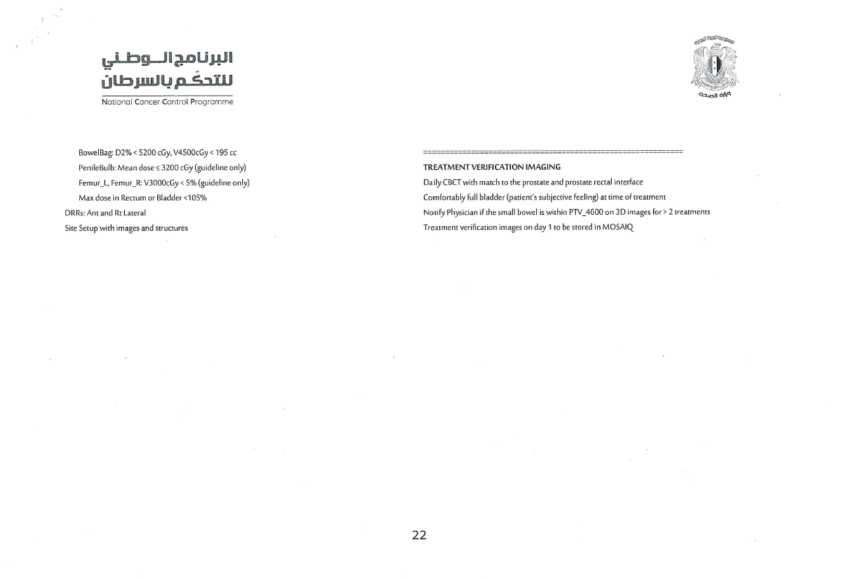

Slide 42
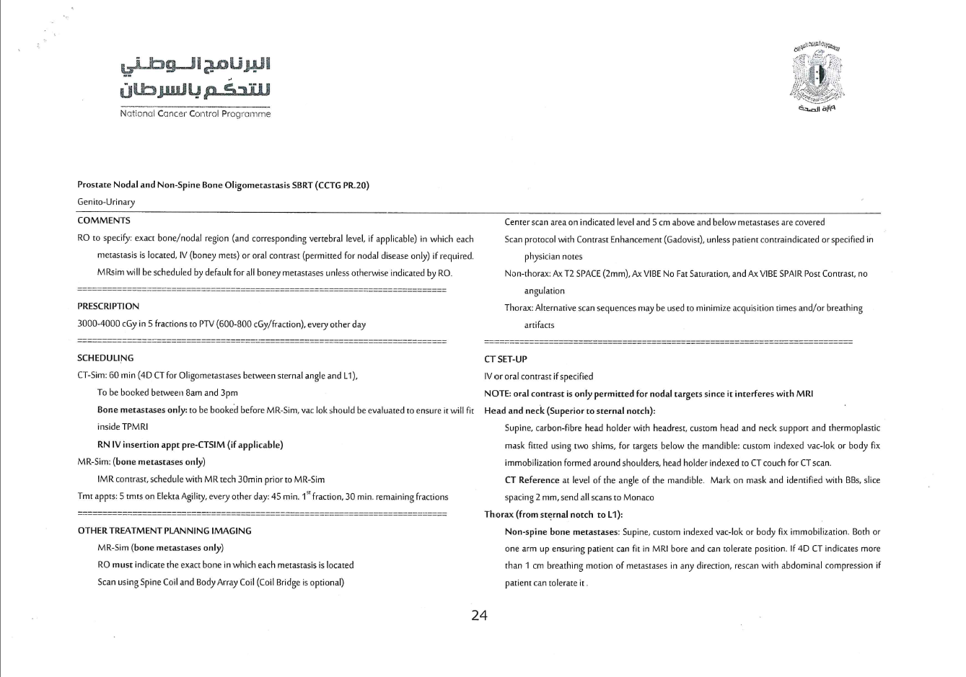

Slide 43
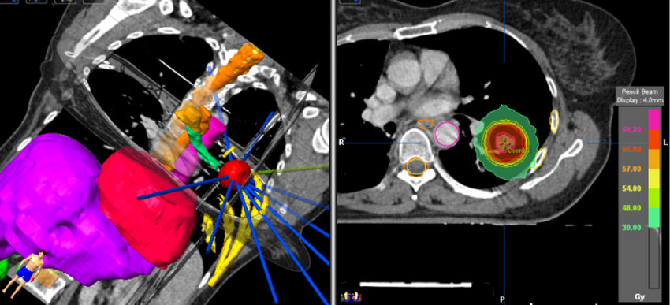

Slide 44
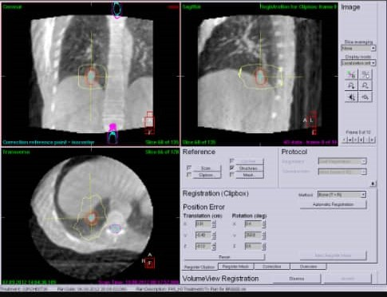

Slide 45
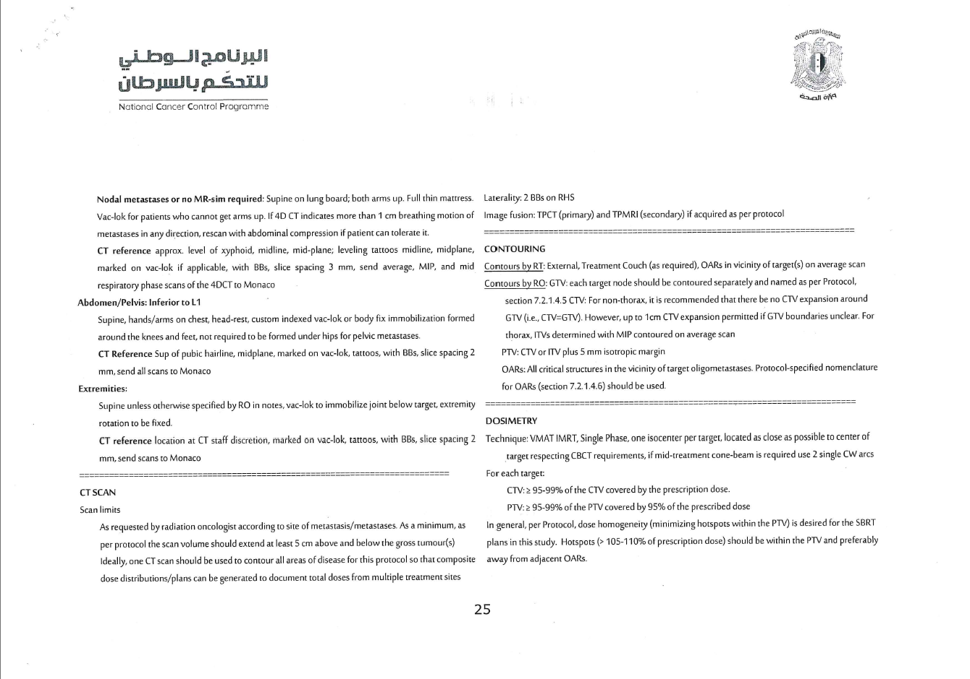

Slide 46
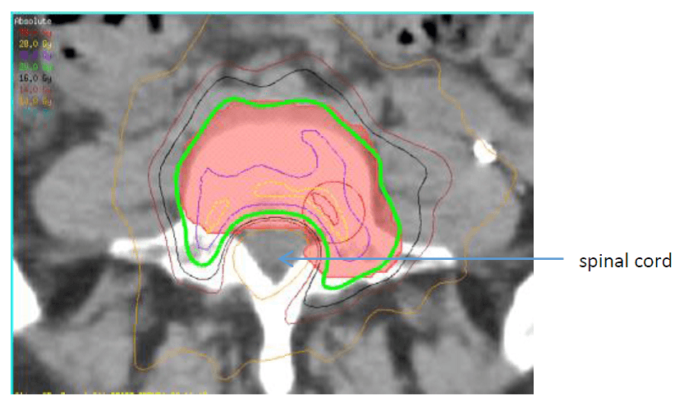

Slide 47
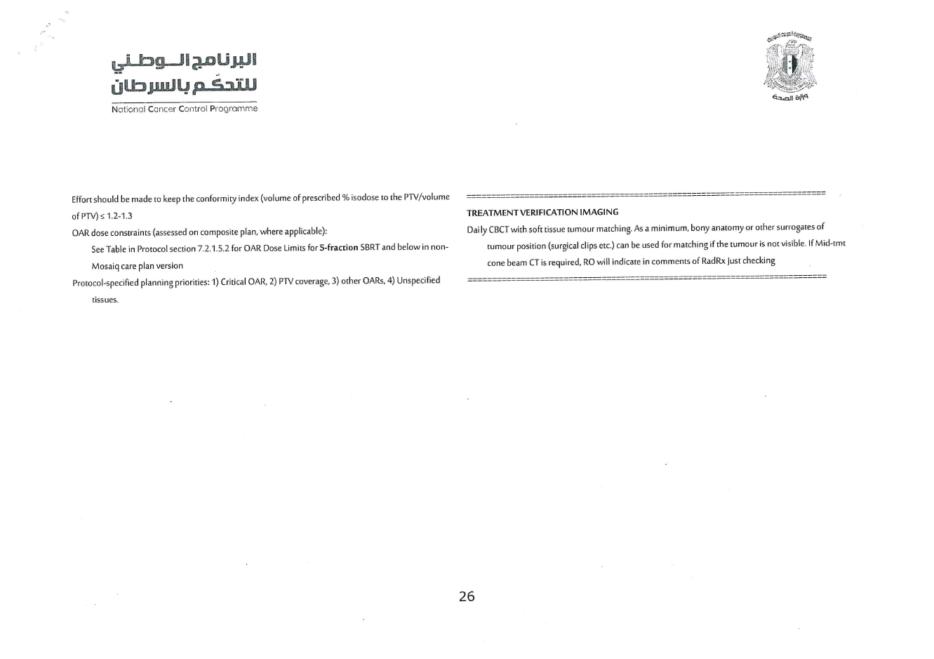

Slide 48
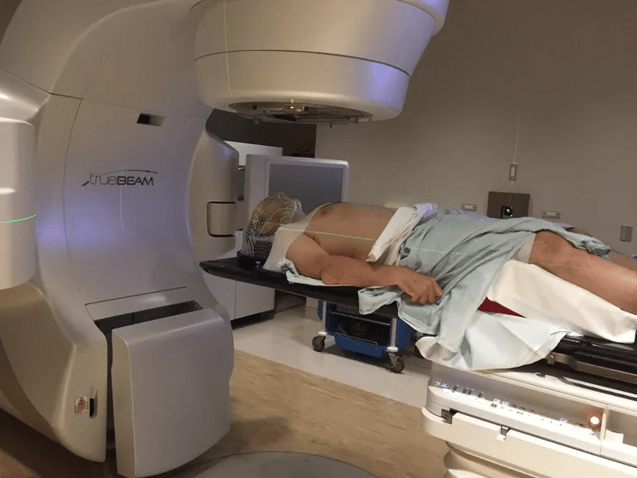

Slide 49
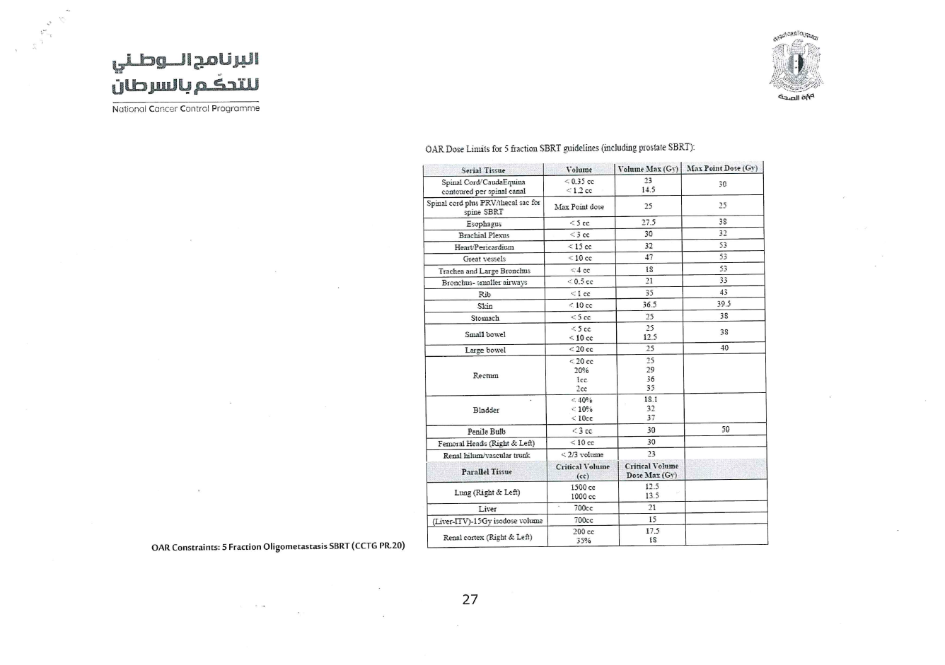

Slide 50
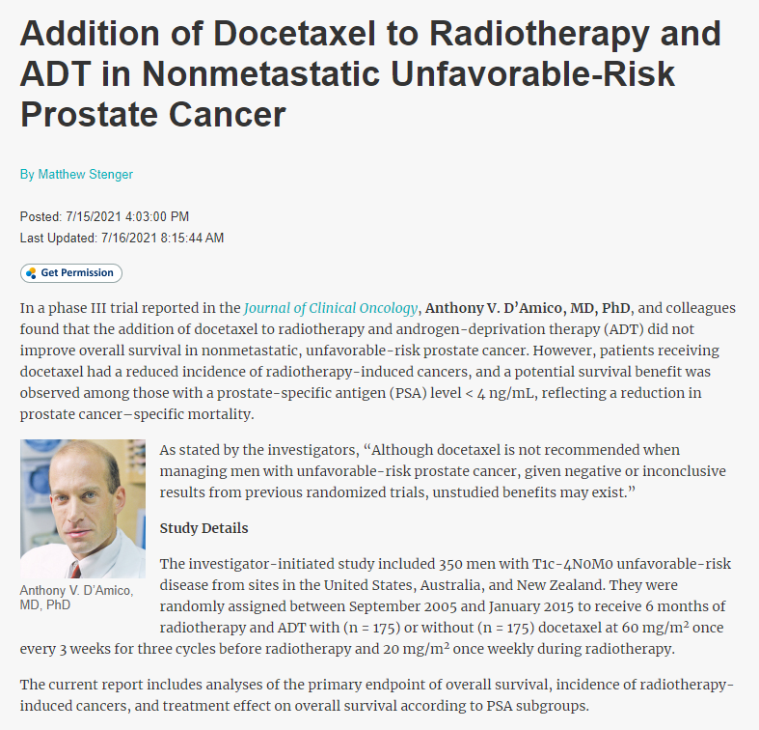

Slide 51
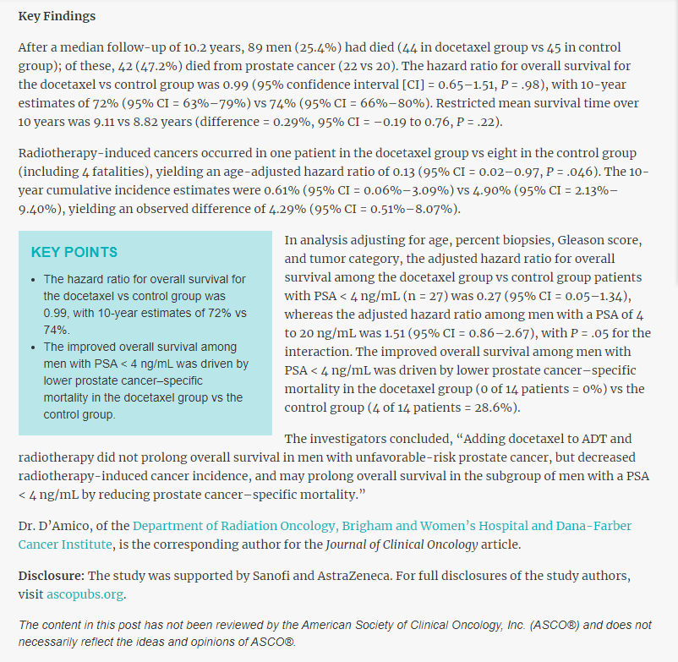

Slide 52
Thanks for listening

Slide 53

Dr- Rabei AlKoli
NATIONAL GUIDELINES IN RADIOTHERAPY

Slide 54
Head & Neck Cancer
General outlines about RT in HNCs
Head and neck tumors and their treatments can cause complex anatomical and functional deficits
Assessment for RT:
History & physical examination including detailed ENT exam.
TNM staging is principal for making therapeutic decisions, based on:
CT scan to document local tumor extent and assess nodes is recommended in all but very early vocal cord tumors.
A chest CT or PET-CT in patients with locally advanced disease to look for metastases or a synchronous primary cancer.
Histological confirmation should be obtained by fine needle aspiration or core biopsy of lymph nodes or by incisional biopsy of the primary tumor or nodes.

Slide 55
Head & Neck Cancer
General outlines about RT in HNCs
Assessment for RT:
The ideal forum for this assessment is a Multi-Disciplinary Team, which includes:
surgeon
Medical Oncologist
Radiation Oncologist
clinical nurse specialist
dietician
speech and language therapist and restorative dentist.

Slide 56
Head & Neck Cancer indications of RT in HNCs:
Primary Tumor – Curative Treatment
Primary Tumor – Adjuvant Treatment
Cervical Nodes – Prophylactic
Cervical Nodes – Curative
Palliative Treatment

Slide 57
Head & Neck Cancer
Primary Tumor
it is important to consider not only tumor control but also long-term function – particularly swallowing and speech
Curative Treatment
Early stages
Adjuvant Treatment
close resection margins
locally advanced tumors (usually T 3/4),
high tumor grade
perineural or vascular invasion

Slide 58
Head & Neck Cancer
Cervical Nodes – Prophylactic
If the risk is greater than (15–20) % the relevant nodal levels should be removed surgically or irradiated prophylactically.
The choice of surgery or radiotherapy to treat the N0 neck is usually determined by the treatment of the primary tumor.

Slide 59
Head & Neck Cancer
Cervical Nodes – Curative
Treatment When staging indicates lymph node involvement, the neck is treated with a neck dissection, radiotherapy or a combination of the two.
Surgery followed by radiotherapy has the advantages of quickly obtaining local control of disease
But radiotherapy volumes are more difficult to define with certainty and precision postoperatively than in the unoperated neck, and there is good evidence that radiation

Slide 60
Head & Neck Cancer
Palliative Treatment
locally advanced disease when the chance of cure is low or potential cure would entail significant morbidity
Metastases : Palliative radiotherapy to the primary site can also be useful when are present at diagnosis, or in locally recurrent disease to ameliorate fungating tumor or reduce bleeding.
palliative radiotherapy may provide control of local symptoms such as pain and airways obstruction.

Slide 61
Head & Neck Cancer
Dose Fractionation
the standard of care 70 Gy in 35 fractions has been the international standard for treatment of the primary site and involved nodes
60 Gy to treat uninvolved nodal regions at particular high risk of disease.
The prophylactic dose to uninvolved lower risk nodal levels is 44–50 Gy.

Slide 62
Head & Neck Cancer
Hypofractionation
Examples are:
50 Gy in 16 fractions
55 Gy in 20 fractions
60 Gy in 25 fractions.
A shorter overall treatment time will reduce the risk of tumor repopulation at the cost of a theoretical
increase in late effects due to the higher dose per fraction

Slide 63
Head & Neck Cancer
Hyperfractionation
uses a higher total dose given in two daily fractions with the same overall treatment time.
An example is the RTOG 9003 schedule of 1.2 Gy given twice daily to a total dose of 81.6 Gy in 68 fractions.
Some altered fractionation regimens are both accelerated and hyperfractionated.
The CHART protocol used 54 Gy in 36 fractions of 1.5 Gy over 12 days and has been shown to produce equivalent local control to 66 Gy in 33 daily fractions.

Slide 64
Head & Neck Cancer
Palliative
The goal of treatment is to improve symptoms and quality of life
A short course of radiotherapy with minimal side effects.
20 Gy in 5 daily fractions
30 Gy in 10 fractions over two weeks
24 Gy in 3 fractions over three weeks

Slide 65
Head & Neck Cancer
Concomitant Radiotherapy and Chemotherapy
Chemotherapy given during a course of conventionally fractionated radiation improves survival compared with radiation alone.
Concomitant chemotherapy increases the acute side effects of radiation
Cisplatin-based chemotherapy is particularly effective, most commonly used with a three-weekly dose of 100 mg/m2 (two to three doses) or a weekly dose of 30–40 mg/m2.
Carboplatin is substituted in renal impairment or if cisplatin is not tolerated.

Slide 66
Head & Neck Cancer
Induction Chemotherapy
The excellent (50–70 percent) response rate of head and neck cancers to cisplatin-based chemotherapy (cisplatin and 5-fluorouracil +/- docetaxel) makes the idea of induction chemotherapy,
given before radiation,
can reduce the volume of disease
improve symptoms and, theoretically,
may reduce the rate of distant metastases.

Slide 67
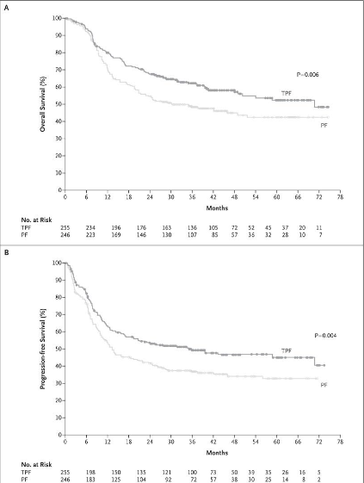
Head & Neck Cancer
Induction Chemotherapy

Slide 68
Head & Neck Cancer
Re-irradiation
Potentially curative re-irradiation can be given in highly selected patients with unresectable local recurrence after previous radiotherapy or for an adjacent unresectable second primary tumor.
The disease free interval should be at least two years
the volume as small as possible.
Elective nodes should not be irradiated.
excellent performance status,
no serious late effects from previous treatment
IMRT or VMAT should normally be used to conform dose more closely to target volumes and to minimize the volume treated to a high dose.

Slide 69
Head & Neck Cancer
HNCs’ workflow:
RO assessment in the clinic
Other related assessment (dental, nutritional,….etc)
CT simulation
Import
LASER localization.
Imaged registration.
Protocols, templates, and scripts
Patient modeling and plan design
Plan optimization
Export and documentation.

Slide 70
Head & Neck Cancer
CT- simulation
Patient preparation → Equipment preparation → Immobilization → Making the mask
Scanning parameters:
* CT slices should be 2–3 mm thick to aid accurate target volume definition and
to produce good quality DRRs for verification.
*Intravenous contrast will highlight the internal jugular vein, and tumor enhancement
can help to define both the primary site and involved lymph nodes
Documentation:
* Co-registration of diagnostic (usually MRI or PET CT) and planning CT scans can help
to define both tumor volumes and critical normal tissues (e.g. optic chiasm, lacrimal
glands)

Slide 71
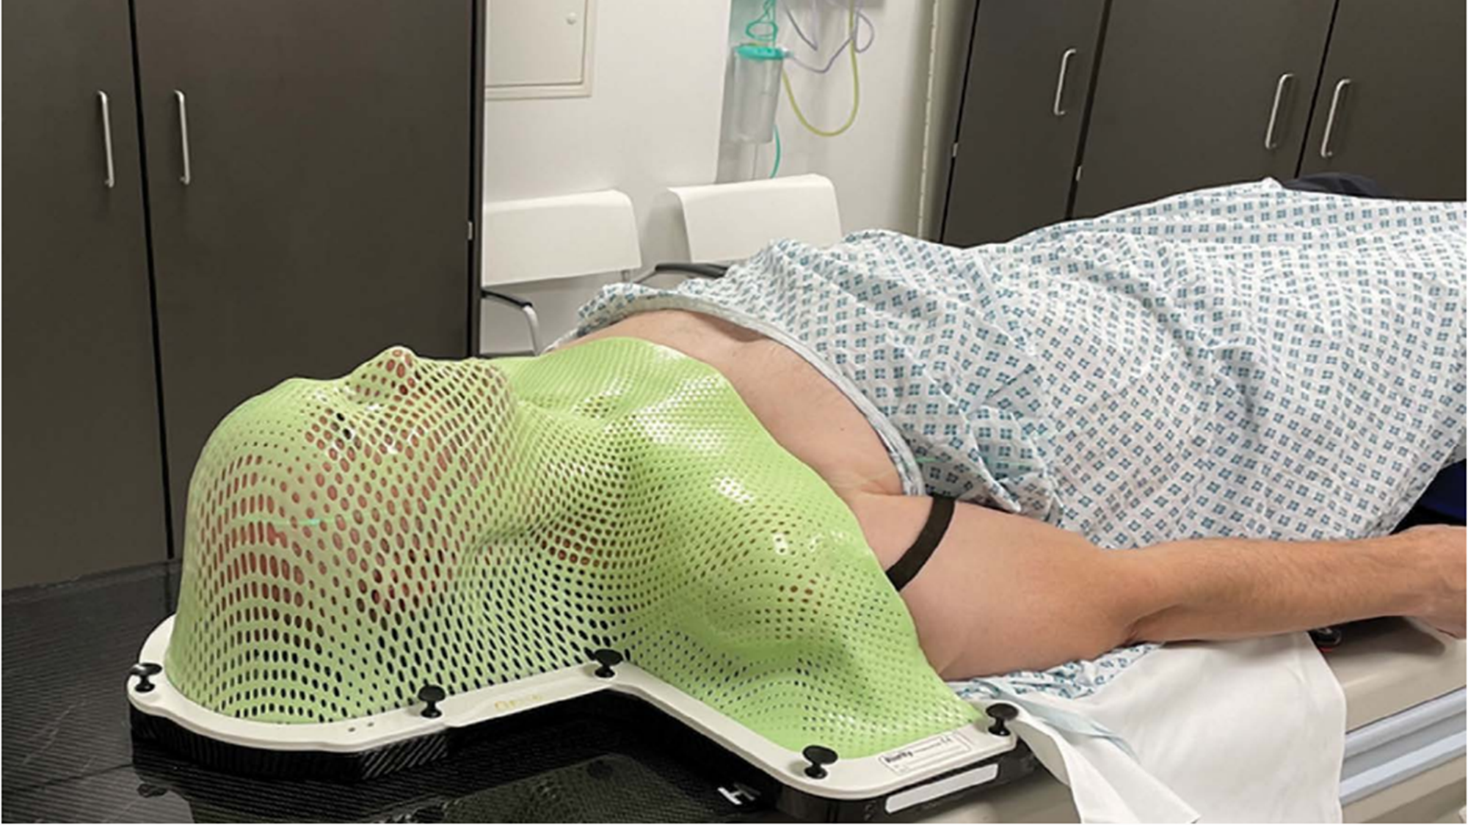
Head & Neck Cancer
CT- simulation (Immobilization- Making the Mask)

Slide 72
Head & Neck Cancer
Target Volume
Target Volume Definition and doses
GTV
CTV
PTV(ptv
ORAs the spinal cord, parotid and submandibular salivary glands, pharyngeal constrictor muscles, optic nerves and chiasm, lacrimal glands and lenses.

Slide 73
Head & Neck Cancer radiotherapy technique
IMRT
VMAT
3D

Slide 74
Head & Neck Cancer plan review
the tolerance of the spinal cord, brainstem or optic nerves are not exceeded.
Then coverage of each PTV 95%
Any organs at risk that have been defined are then assessed, such as the salivary glands.
Dose max 107%

Slide 75
Head & Neck Cancer
Verification and Image Guidance
kV CBCTs
MV CBCT

Slide 76
Head & Neck Cancer
Tumor type / site specific principles of radiotherapy
Subsite guidelines
Nasopharynx
Oropharynx
Oral cavity
Larynx
Hypopharynx
Unknown primary
Salivary gland
High-risk squamous cell skin carcinoma
Nasal cavity / paranasal sinuses
Locoregional recurrence

Slide 77
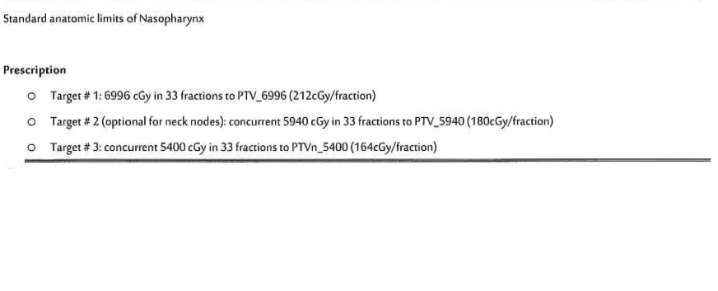

Slide 78
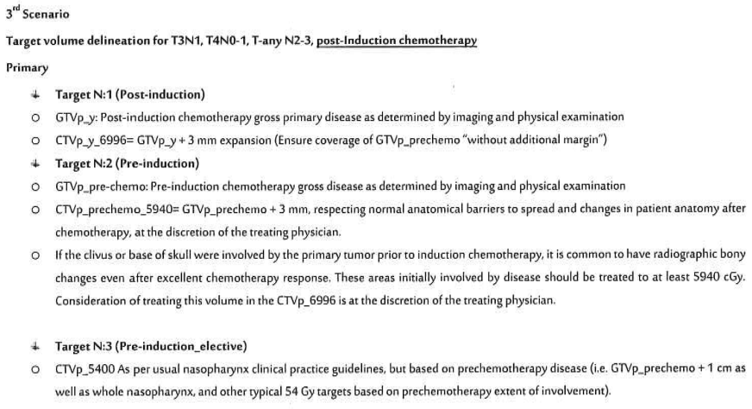

Slide 79
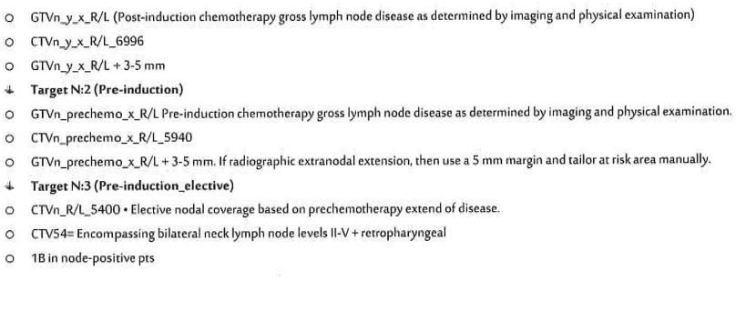

Slide 80


Slide 81


Slide 83


Slide 84


Slide 86


Slide 87
Thanks For listening

Slide 88

Pr.Dr-Moudar Bakkour
NATIONAL GUIDELINES IN RADIOTHERAPY

Slide 89
Rectal cancer- Treatment Recommendations

Slide 90
Rectal cancer- Radiation Technique
Three dimensional RT standard of care
New advances RT minimize toxicity and maximize efficacy.
Intensity Modulated and Image guided RT anatomically dose delivery reduce CTV-PTV margin and irradiated volume of small bowel, Used in selective cases:
Post operative
Unable to tolerate prone position
Treating inguinal nodes

Slide 91


Rectal cancer- Positioning & immobilization
  Supine/prone
  Pelvic thermoplastic mask
  CT simulation
Behind sacrum
Superior: L5-S1
Inferior: 3 cm below gross disease
Lateral: 1.5 cm margins on the pelvic brim
Superior: L5-S1
Lateral field
Posterior / anterior margin of pubic symphysis
PA field
Inferior: 3 cm below gross disease

Slide 92

Rectal cancer- Target volumes
GTV= primary tumor based on exam+ endoscopic and imaging.
For post operative, use pre-operative image to define tumor bed

Slide 93

Rectal cancer- Target volumes
CTV: GTV + (2-3) cm margin, perirectal, presacral and internal iliac nodes
(+ external iliac nodes for T4)
(+ Inguinal nodes if anal canal involved)

Slide 94

Rectal cancer- Target volumes
PTV: CTV + (0.5- 0.7) cm

Slide 95

Rectal cancer- Target volumes

Slide 96

Rectal cancer- Organs At Risk
Small bowel
Bladder
Femoral head

Slide 97


Rectal cancer- Plan evaluation :
Dose volume histogram

Slide 98

Rectal cancer- Plan evaluation :

Slide 99

Pr.Dr-Moudar Bakkour
NATIONAL GUIDELINES IN RADIOTHERAPY

Slide 100


Gynecologic Cancer (Uterus & Cervix)
Types of RadioTherapy
External Beam Radiotherapy
Brachytherapy

Slide 101

Gynecologic Cancer (Uterus)- Indications of RT

Slide 102

Gynecologic Cancer (Cervix)- Indications of RT

Slide 103
Gynecologic Cancer (Uterus & Cervix)
Timing of radiation therapy
Adjuvant RT: within 6-8 weeks post operative, but not later than 12 weeks.
HDRBT: any time during EBRT or immediately after completion of EBRT.
2 insertion / week will be performed with no EBRT on the day of brachytherapy.

Slide 104
Gynecologic Cancer (Uterus & Cervix)
Positioning & immobilization
Simulation is performed in the supine position; vaginal and rectal markers are placed into
Full bladder and empty rectum
the patient. Oral contrast material may be beneficial for the visualization of intestines.
CT scan thickness slice <3mm

Slide 105


Gynecologic Cancer (Uterus & Cervix)
Field border
Extended field
Conventional field
AP-PA Portal borders:
Superior: a transverse line between D12 and L1
Inferior: 3cm below the most distal vaginal disease
Lateral: 1.5- 2 cm lateral to widest true pelvic diameter
Lateral Portal:
Anterior: 0.5 cm anterior to the symphysis pubis edge and at least 1 cm anterior to common iliac nodesat L4-L5
AP-PA Portal borders:
Superior: a transverse line between L4-L5
Inferior: 3cm below the most distal vaginal disease
Lateral: 1.75 cm lateral to widest true pelvic diameter
Lateral Portal:
Anterior: 0.5 cm anterior to the symphysis pubis edge and at least 1 cm anterior to common iliac nodesat L4-L5

Slide 106

Gynecologic Cancer (Uterus & Cervix)
Target Volume- GTV
Definitive RT
GTV = primary Tumor + entire cervix/ entire uterus
Post operative
GTV = Tumor bed+ entire cervix/ entire uterus

Slide 107

Gynecologic Cancer (Uterus & Cervix)
Target Volume- CTV
Definitive RT
CTVn = common + external + internal iliac, presacral (superior border L4-L5)
Post operative
CTVp = Parametria+ upper third/ half of the vagina

Slide 108

Gynecologic Cancer (Uterus & Cervix)
Target Volume- PTV
Definitive RT
PTVn = CTVn + (5-7) mm margin
Post operative
PTVp = CTVp + (1.5-2) cm margin

Slide 109

Gynecologic Cancer (Uterus & Cervix)
Target Volume- OAR
Bladder
Bowel
Rectum
Spinal cord
Femoral Heads
Kidneys

Slide 110
Gynecologic Cancer (Uterus & Cervix)
Dose–Fractionation
Postoperative RT:
Preoperative RT:
Pelvic RT: 45 Gy/1.8 Gy
Pelvic extension: total dose 50.4 Gy
Vaginal cuff BT: 3 × 6–7 Gy (HDR)
BT alone: 6 × 5.5–6 Gy (HDR)
Pelvic RT: 45 Gy/1.8 Gy
Vaginal extension; total dose 50.4 Gy.
Intracavitary BT: 3 × 6–7 Gy (HDR)
• Paraaortic LN (+) :
Pelvic/paraaortic RT + vaginal cuff BT

Slide 111

Gynecologic Cancer (Uterus & Cervix)
OAR

Slide 112




Gynecologic Cancer (Uterus & Cervix)
Dose volume histogram

Slide 113
Gynecologic Cancer (Uterus & Cervix)
Brachytherapy
Postoperative vaginal BT.
Intra cavity BT.

Slide 114








Gynecologic Cancer (Uterus & Cervix)
Brachytherapy
Applicators
Radiant source
Radioactive elements used:
Cesium 137:
half-life = 30 years
Titrated every 6 months
Replaced every 10- 15 years

Slide 115



Gynecologic Cancer (Uterus & Cervix)
Brachytherapy

Slide 116


Gynecologic Cancer (Uterus & Cervix)
Brachytherapy

Slide 117


Gynecologic Cancer (Uterus & Cervix)
Brachytherapy

Slide 118



Gynecologic Cancer (Uterus & Cervix)
Brachytherapy- Dose
• Low Dose Rate (LDR) | Medium dose rate (MDR) | High Dose Rate (HDR) | PDR
regiment would be <200 cGy/hr using (Cesium-137 or Iridium-192 pellets); treatment 1-3 days (continuous). Dose: 0.4 to 2 Gy/hr | Dose: 2 to 12 Gy/hr | regiment would be 200-300 cGy/min (Iridium-192 or Cobalt-60 pellets); treatment measured in minutes and fractionated. Dose: Gy/hr ~ 2.5 Gy/min | PDR: 30 min.-3 hrs. between pulses, with or without break during the night (incomplete?),

Slide 119


Gynecologic Cancer (Uterus & Cervix)
Brachytherapy

Slide 120
Thanks for listening

Slide 121


Thank you for listening
Questions??

